Slide 1
Storybook Mode 2 Rough Draft #1.2
Bard from Racha Den DEMO
23 August 2023

Slide 2
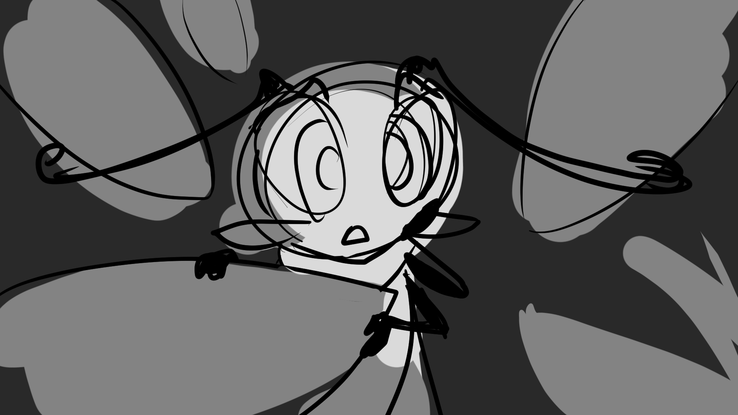
Deanna peeked through the foliage…
Notes:
SHOW “bg stb2_page 1” / Dialogue / FADE TO page 2.

Slide 3
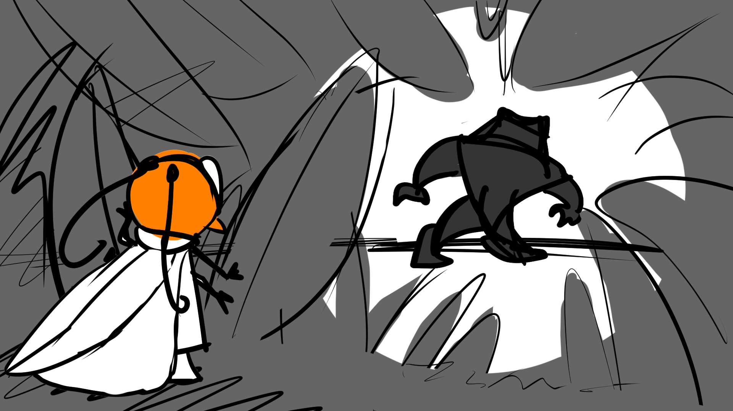
Shaking in her booties, Deanna doesn’t take the chance. She backs away… slowly… slowly...
…only to spy a large, brutish figure stalking the shady grove up ahead.
But then—Snap! Deanna stepped on a twig!
Notes:
SHOW ”bg stb2_page 2” / dialogue / FAST ZOOM TO page 3.

Slide 4
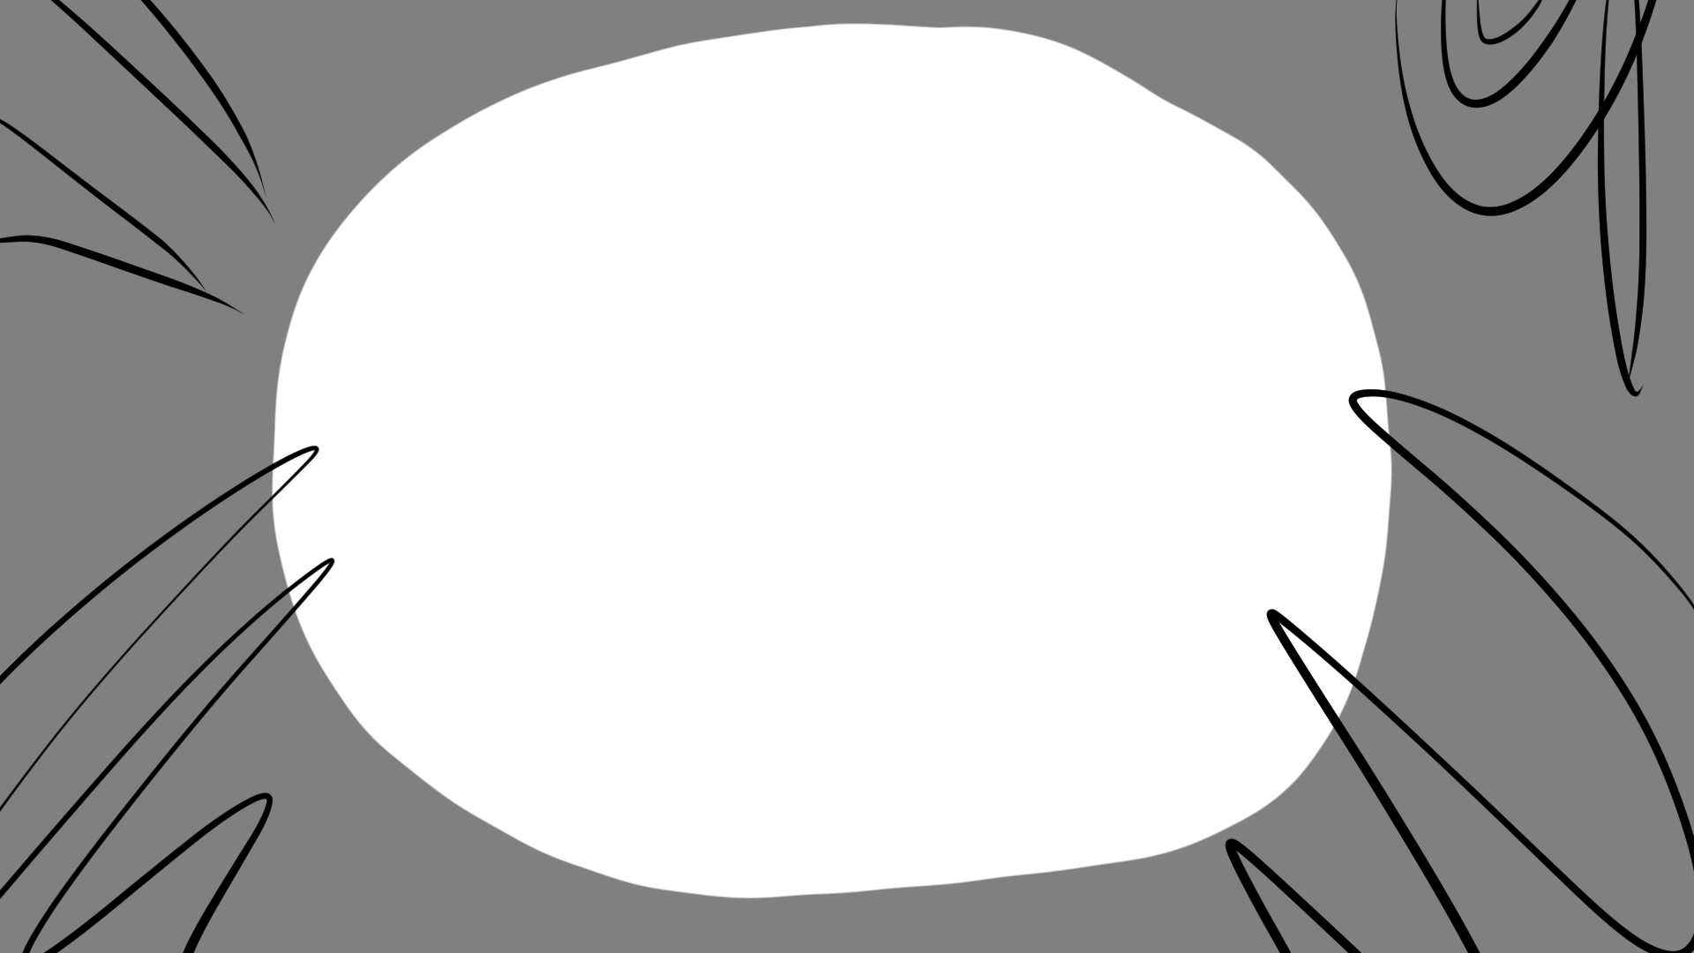
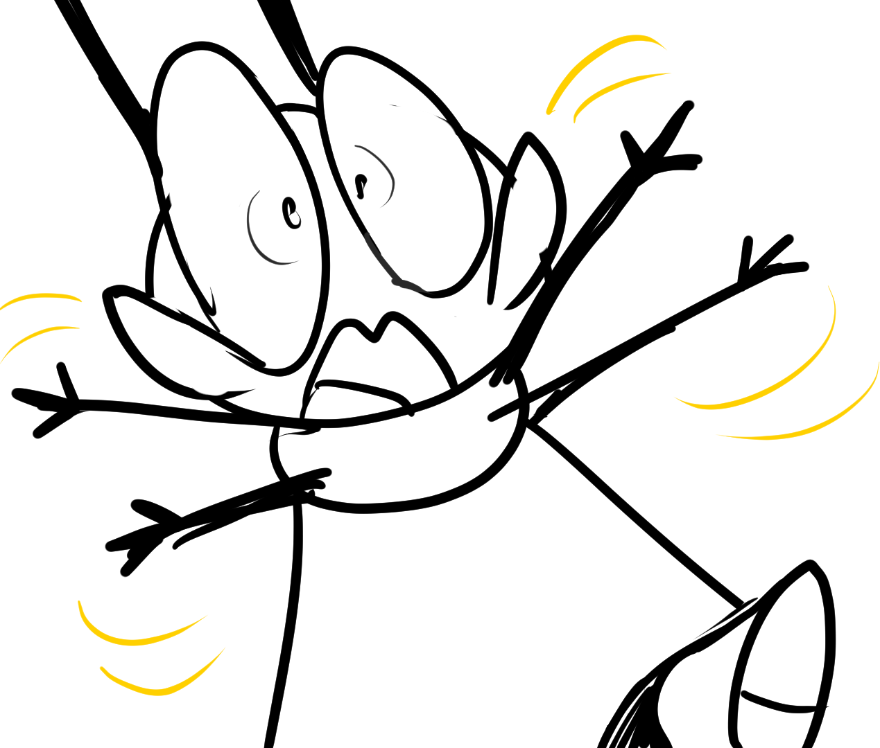
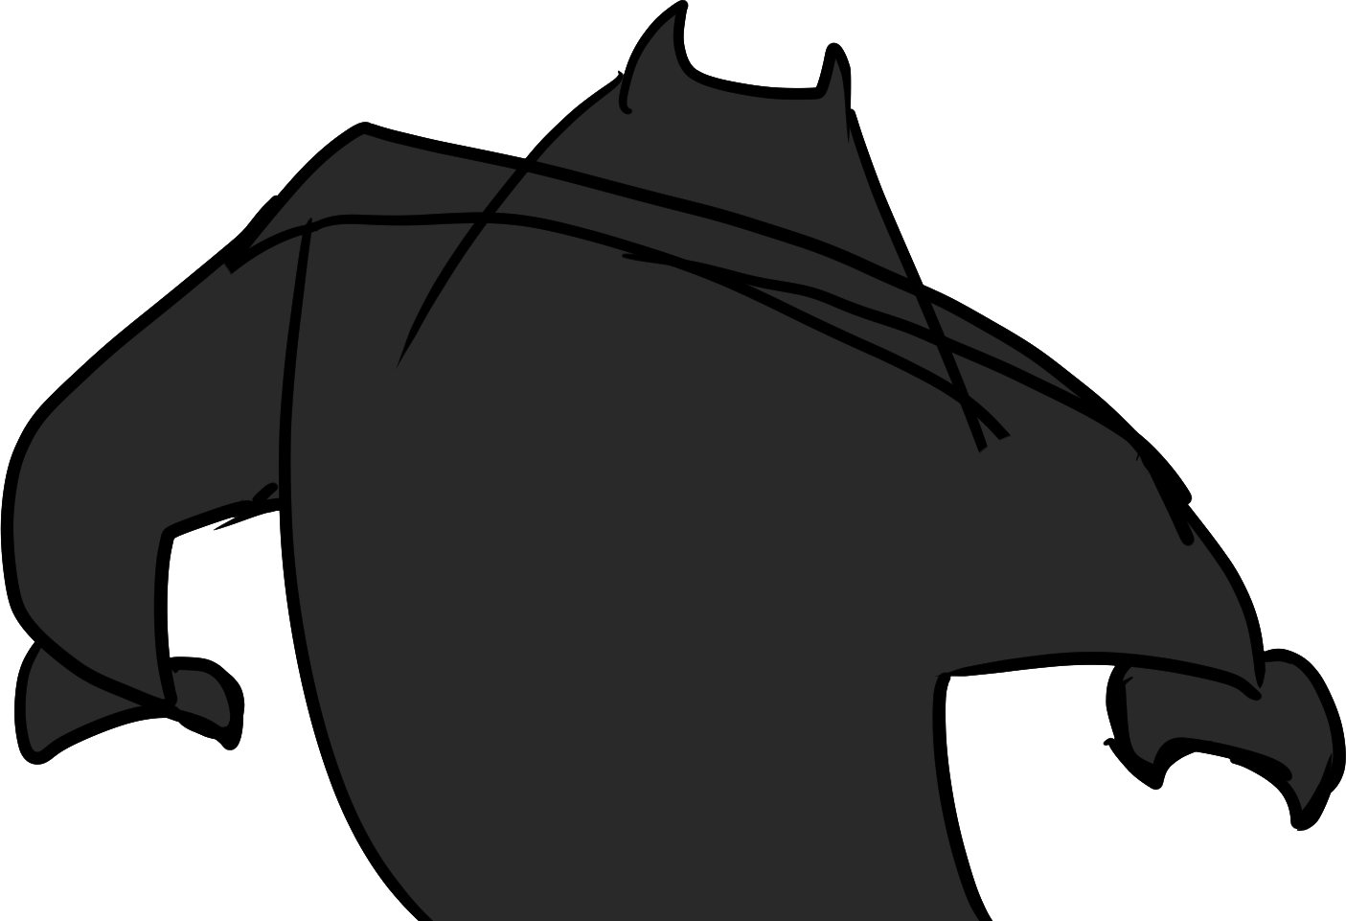
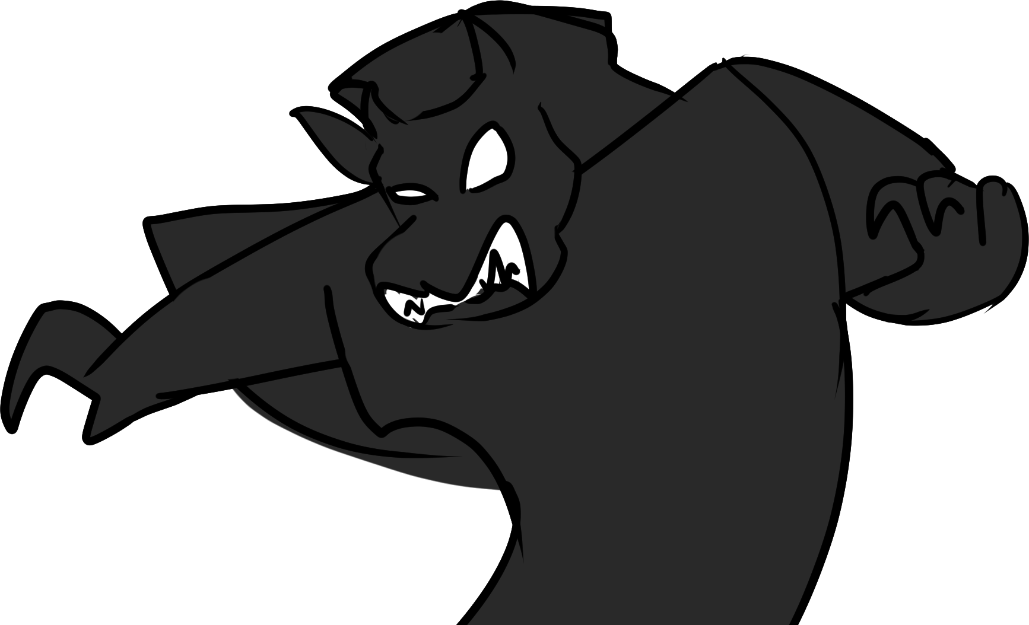
Deanna
A monster! A monster spotted her!
“Aaaaaaaaaaaah!”
Notes:
SHOW “bg stb2_page 3” with “stb2_page 3_scary figure 1” / ANIMATE TO “stb2_page 3_scary figure 2” / PUSH UP “stb2_page 3_d screaming” stage left / dialogue / FADE TO page 4.

Slide 5
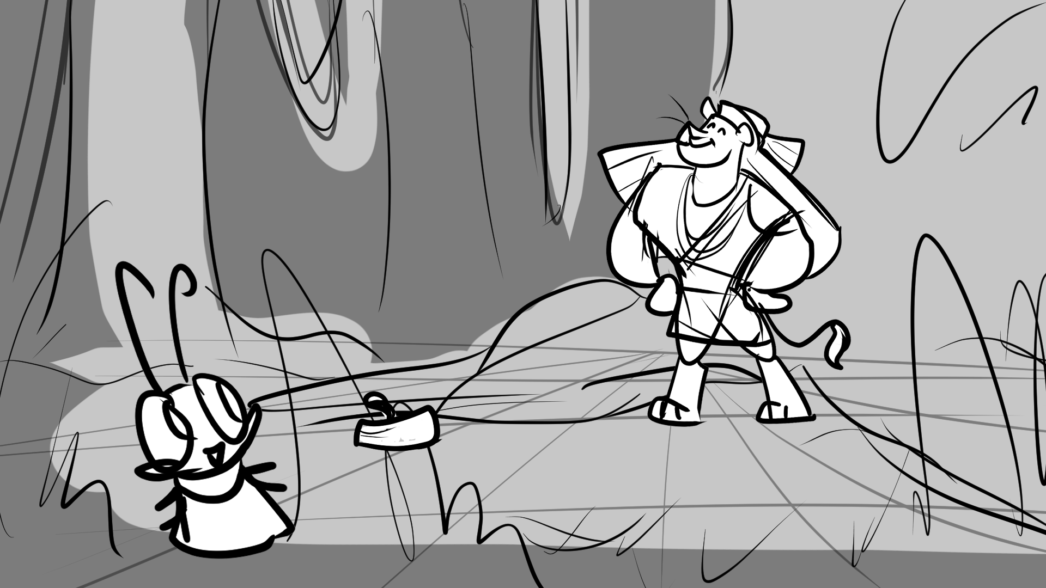
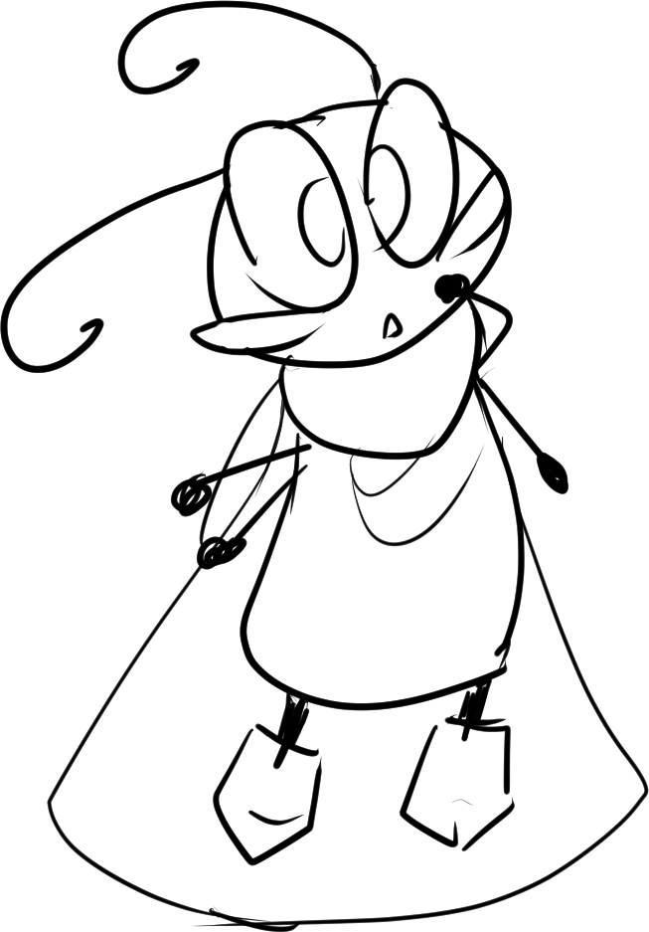
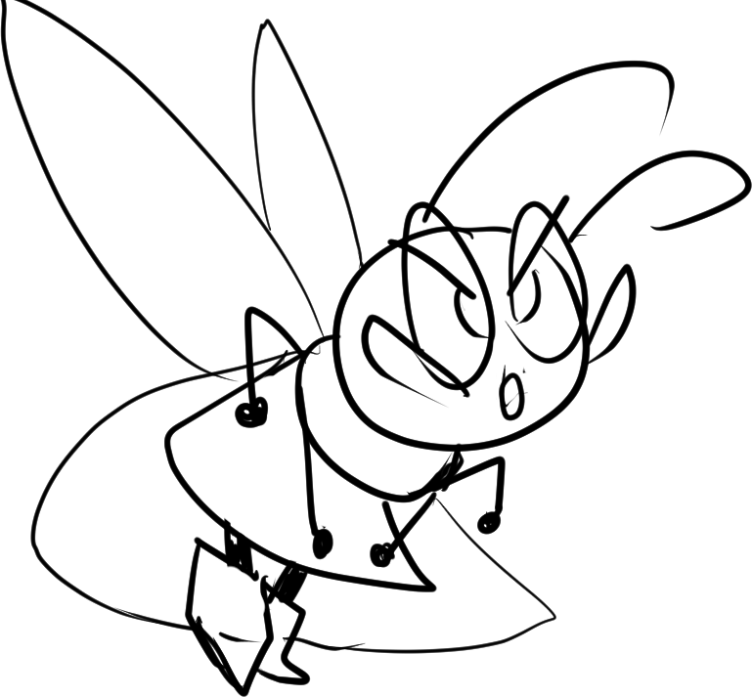
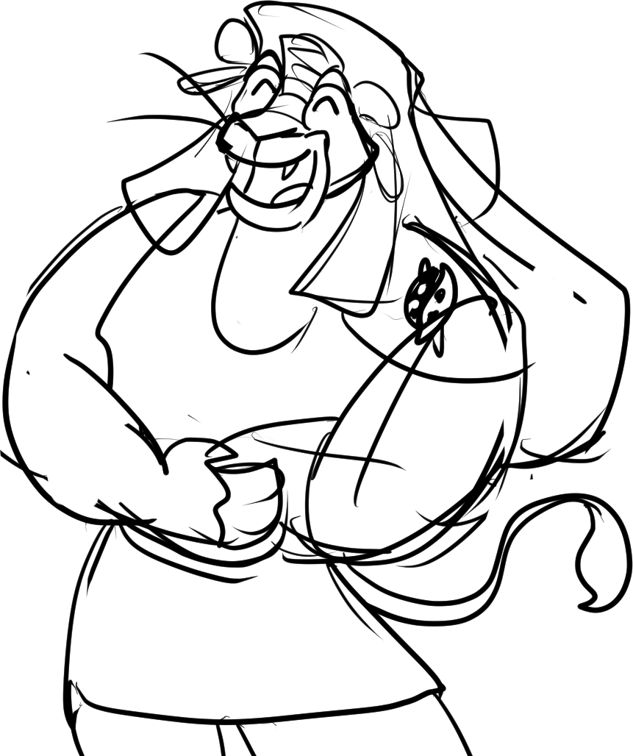
Deanna
Lethabo
Deanna
Lethabo stifles a laugh and points up. Deanna then hears a disgruntled, “Ah-hem…”
Wait a minute! That was no monster. It was her lion friend, Lethabo!
“But wait! If you’re here, then where’s Athos?”
“You scared me, patinaai osim! Wa-ha-ha-ha-ha! ”
“Lethabo! You scared me!”
Notes:
SHOW “bg stb2_page 4” / dialogue / TILT UP to page 5.

Slide 6
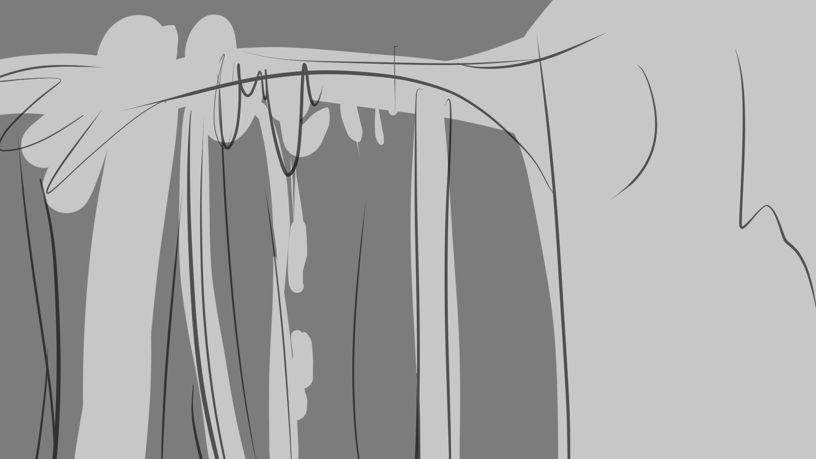


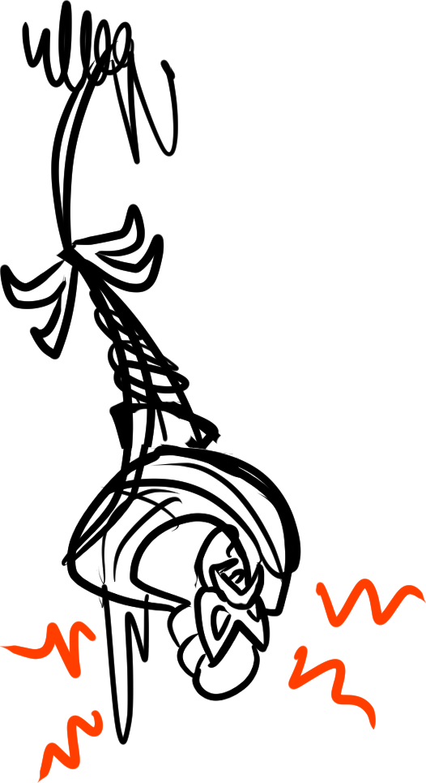
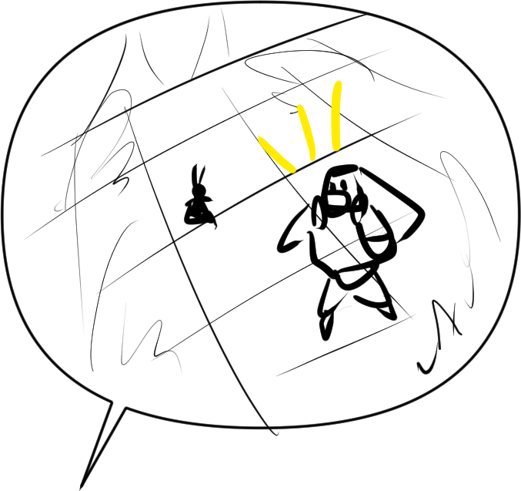
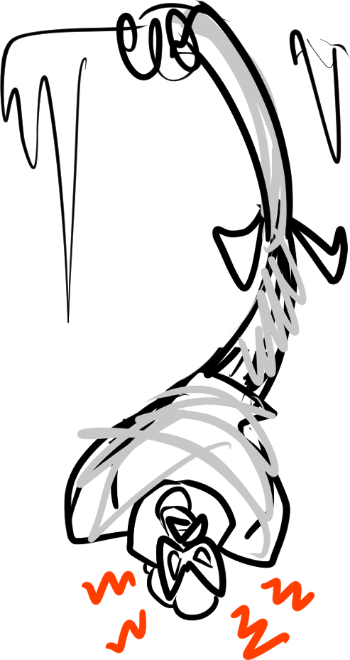
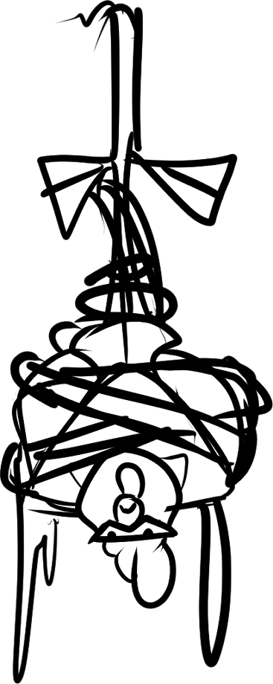
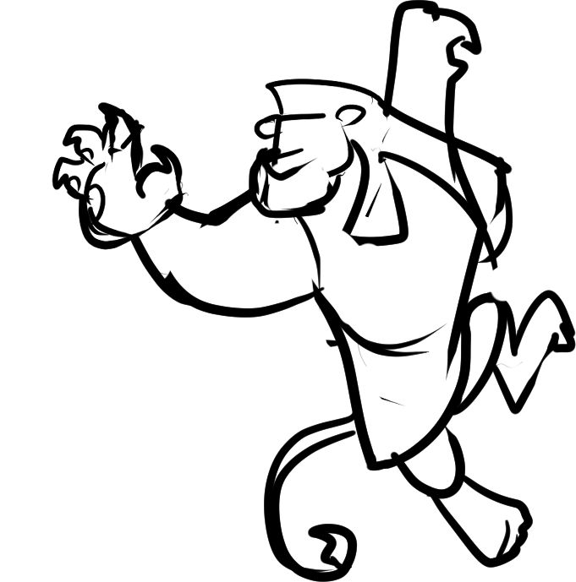
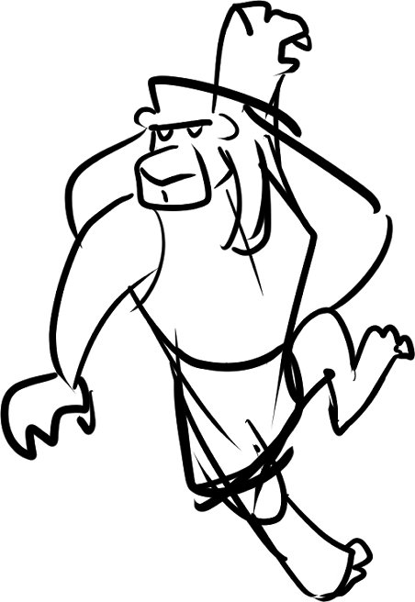
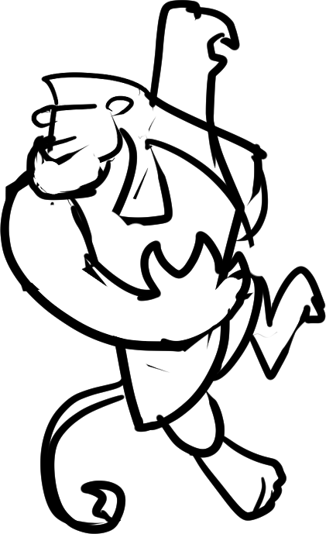
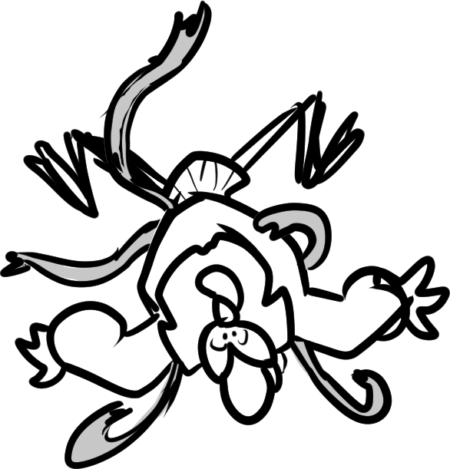

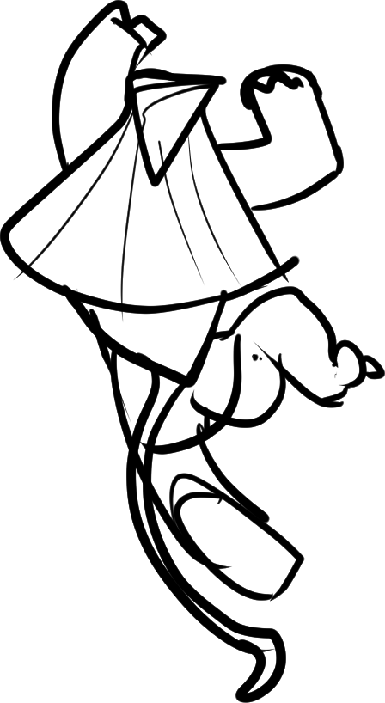
Athos
Athos
Lethabo
Lethabo
“Lucky?! We’ve been imprisoned by a crazy monkey—who just left us to die to a nightmarish monster of legend—which is apparently real!”
And there was Athos stuck in a tree! All tangled up in vines!
He didn’t look pleased in the slightest.
“Look on the bright side, Athos! At least we were lucky enough to have the vines break our fall!”
“Athos… Watch your tongue. There are children present.”
“Ooooh, if ever I see that monkey again, I swear I will… I will…Sua faccio un mazzo così!”
Lethabo had climbed the tree, readied his claw, and—!
Notes:
SHOW “bg stb2_page 5” / SHOW “stb2_page 5_athos hanging 1”/ ANIMATE “stb2_page 5_athos hanging 2” to “stb2_page 5_athos hanging 3” / ANIMATE “stb2_page 5_lethabo on tree 1” to “stb2_page 5_lethabo on tree 2” / ANIMATE “stb2_page 5_lethabo on tree” to “stb2_page 5_slash 1” to “stb2_page 5_slash 2” to “stb2_page 5_lethabo on tree 4” and “stb2_page 5_athos hanging 4” to “athos hanging 5” / CUT TO page 6.

Slide 7
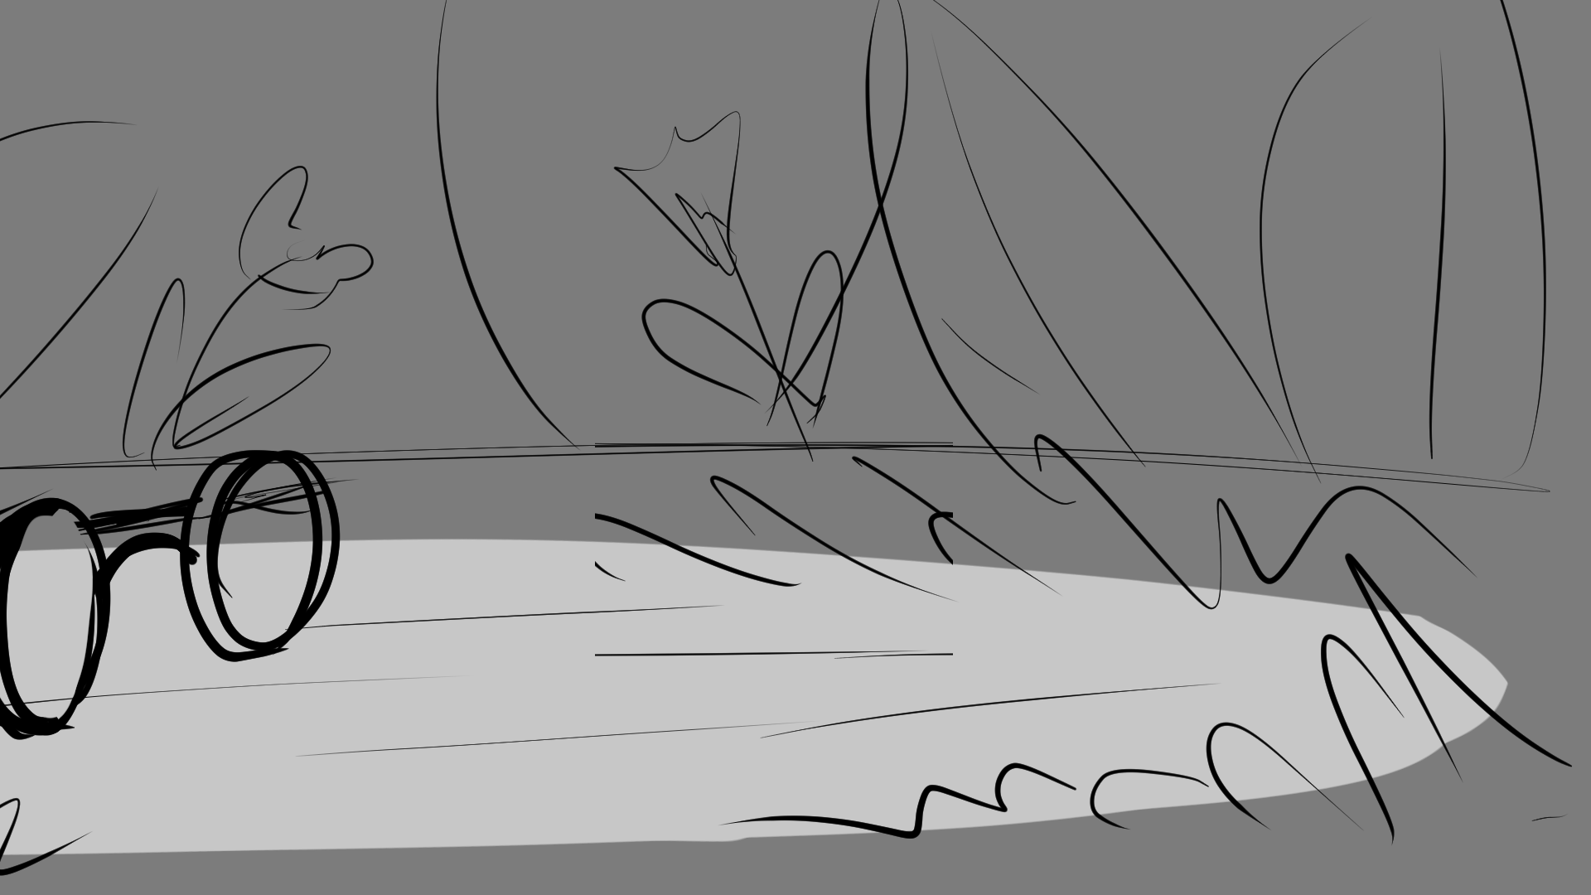

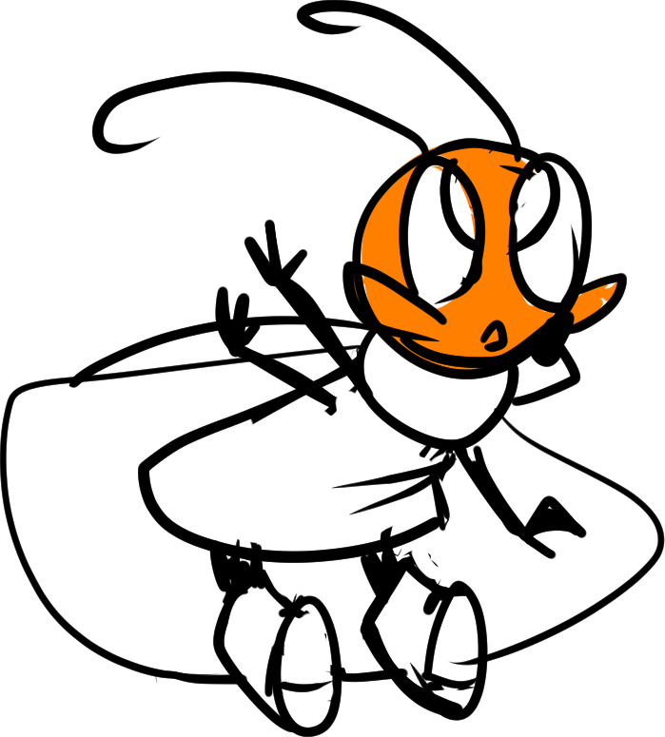
Athos tumbles back to solid ground!
Notes:
SHOW “bg stb2_page 6” / ANIMATE “stb2_page 6_deanna look 1” to “stb2_page 6_deanna look 2” with SHAKING CAMERA / PAN STAGE LEFT to page 7.

Slide 8
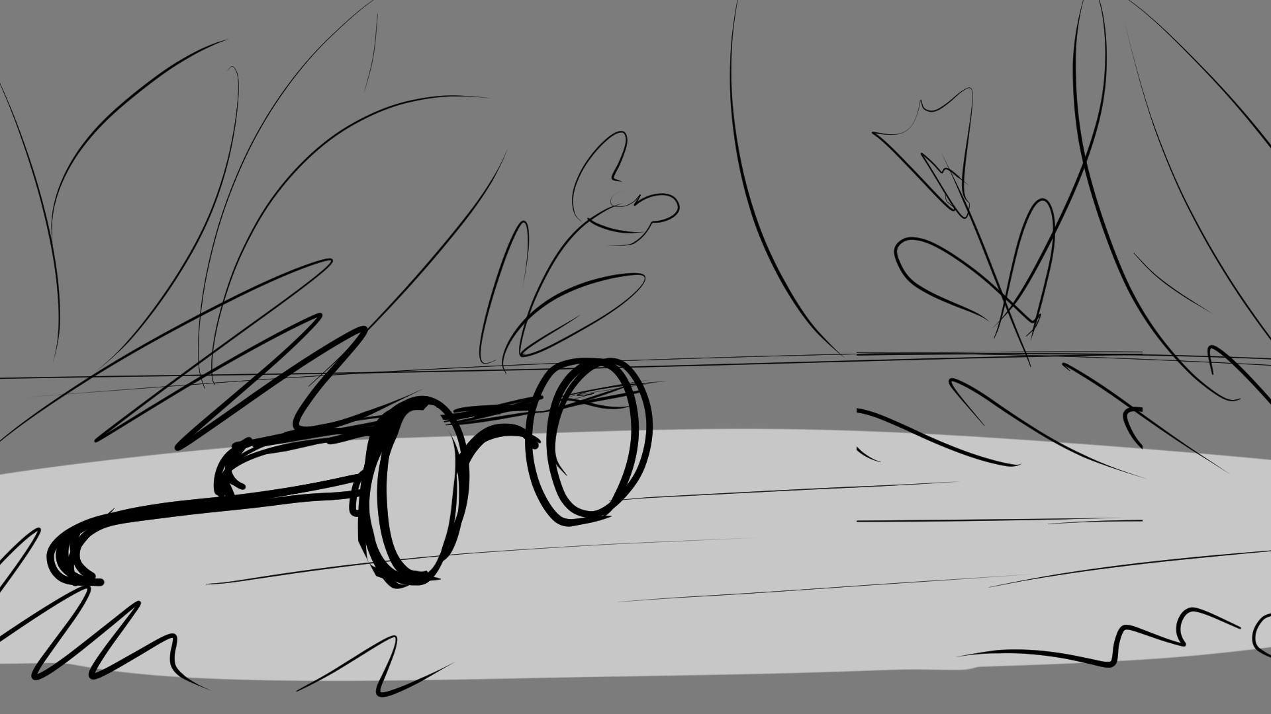

Deanna
“Oh!”
Notes:
SHOW “bg stb2_page 7” / FADE “stb2_page 7_deanna look 3” / FADE TO page 8.

Slide 9
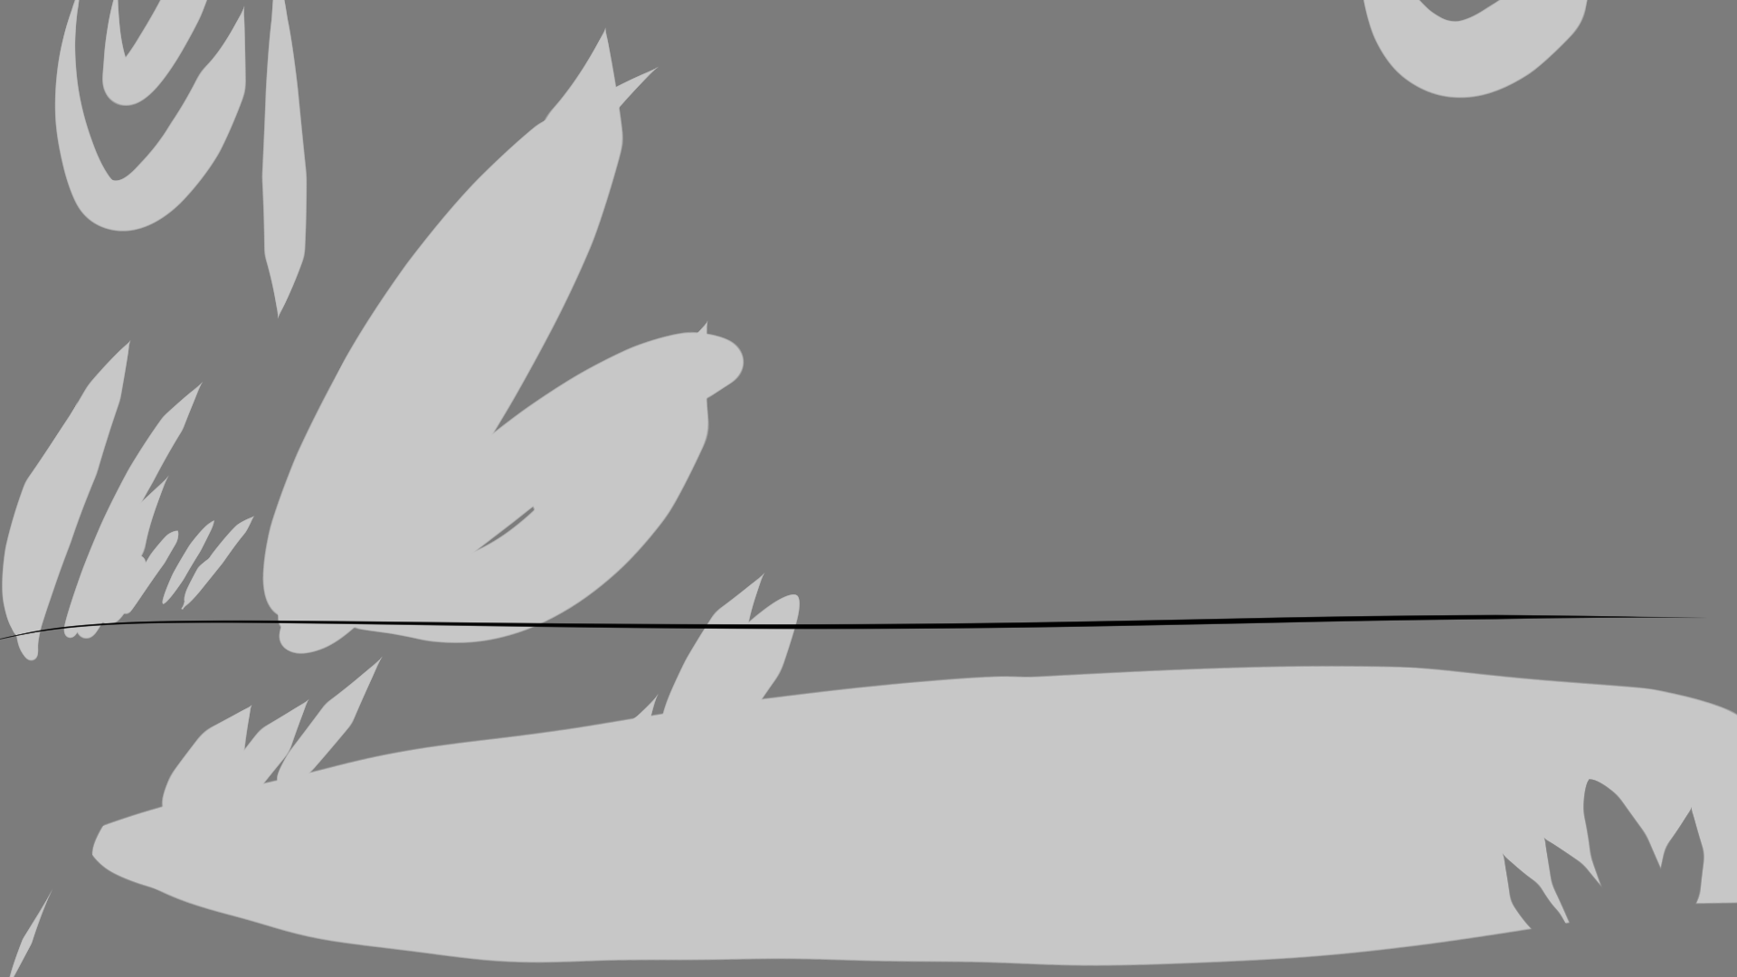
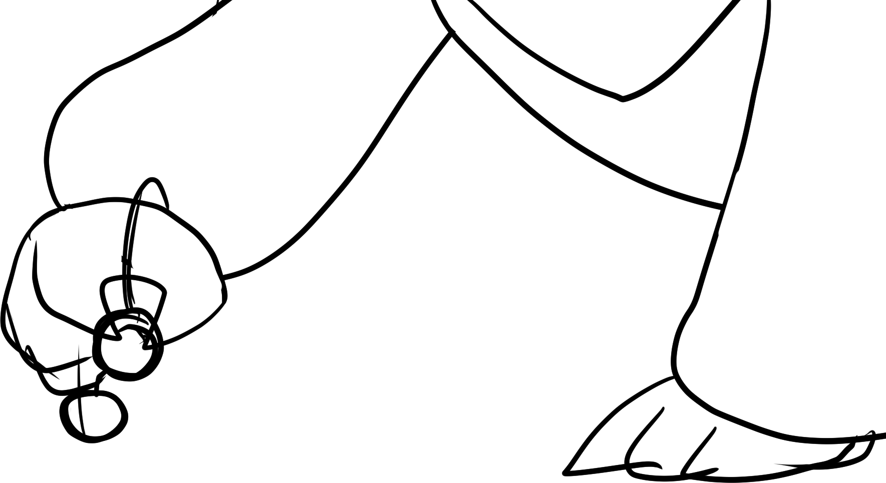
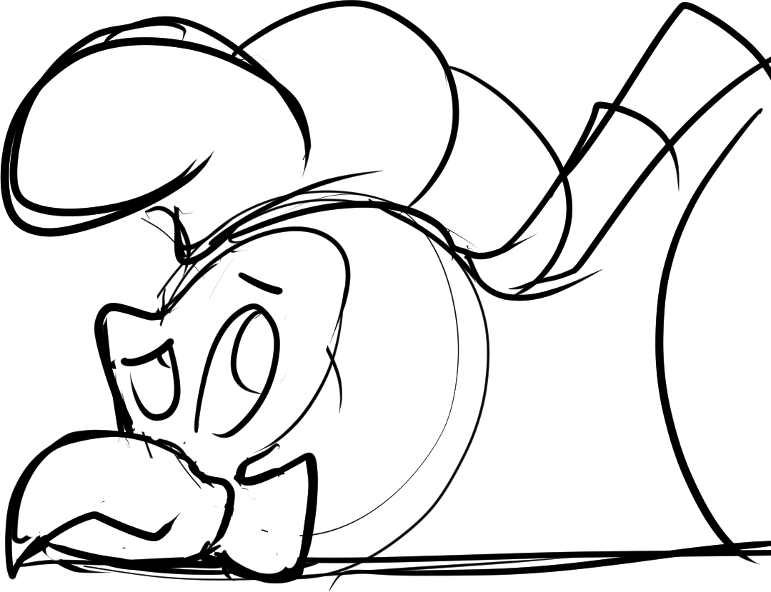
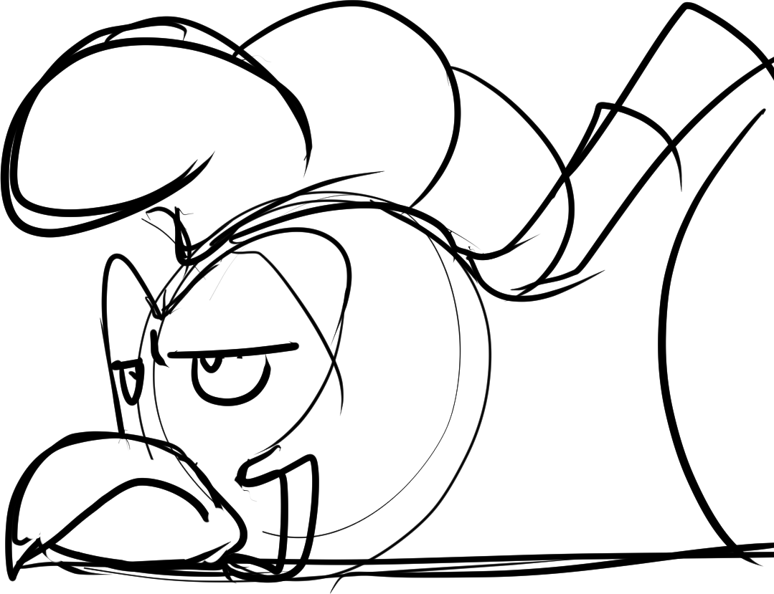
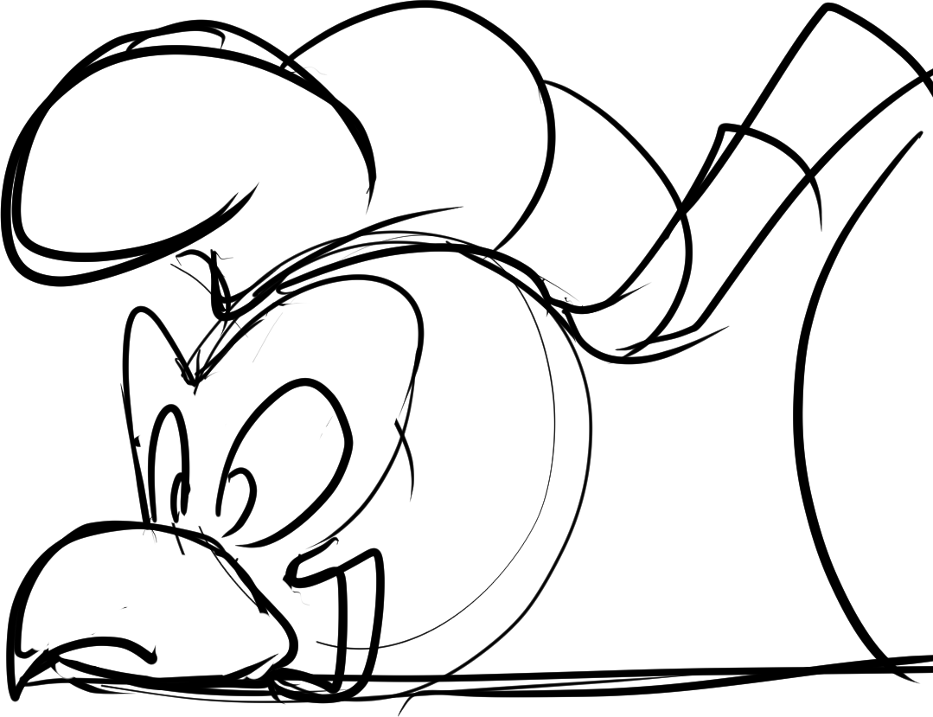
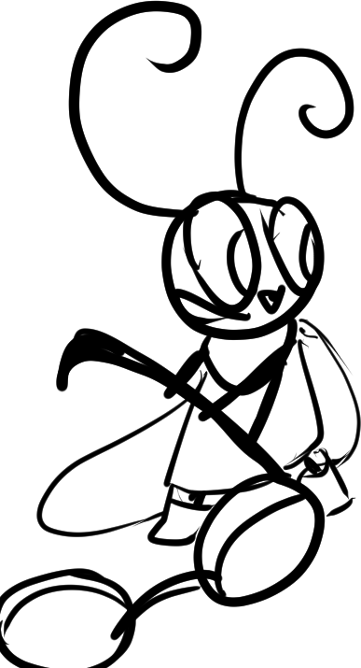
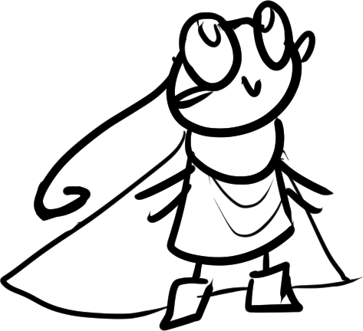
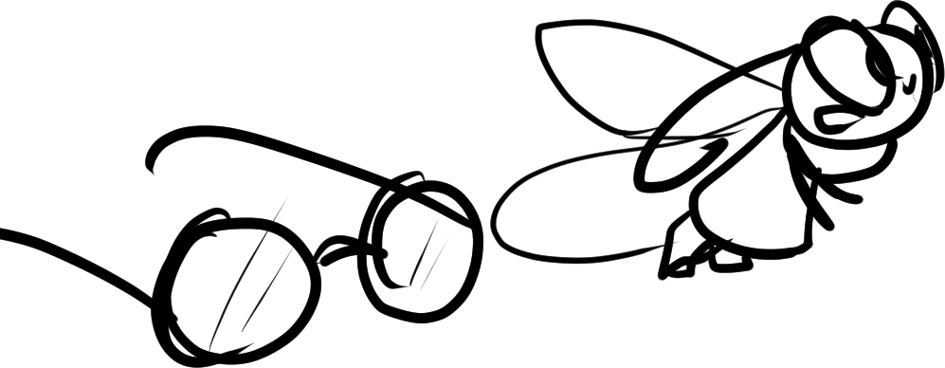
Deanna
Deanna
Athos
Athos huffed with annoyance before Deanna dragged in a pair of spectacles.
What a relief! It seems everyone has made it okay from the big crash!
Though what are they to do now? Lost in this giant rainforest?
”I’m happy to see you’re okay!”
“I found your glasses!”
”Grazie, topolina.”
Notes:
SHOW ”bg stb2_page 8” with “stb2_page 8_athos on floor 1” / dialogue / ANIMATE “stb2_page 8_deanna 1” to “stb2_page 8_deanna 2” / FADE IN “stb2_page 8_athos on floor 2” / FADE TO “stb2_page 8_athos on floor 3” with dialogue / FADE TO “stb2_page 8_deanna 3” and “stb2_page 8_athos on floor 4” / FADE OUT “stb2_page 8_athos on floor 4” / show dialogue / CUT TO page 9.

Slide 10



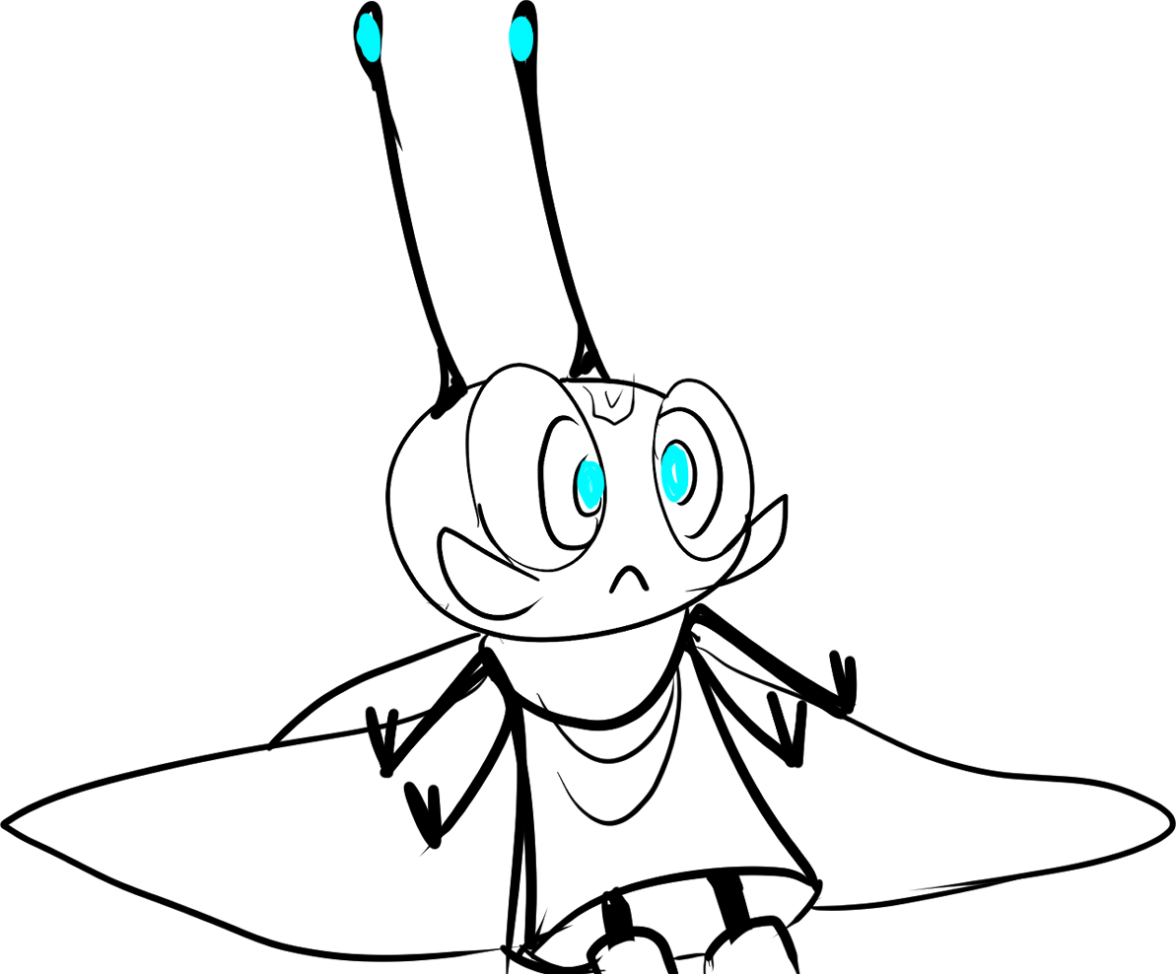
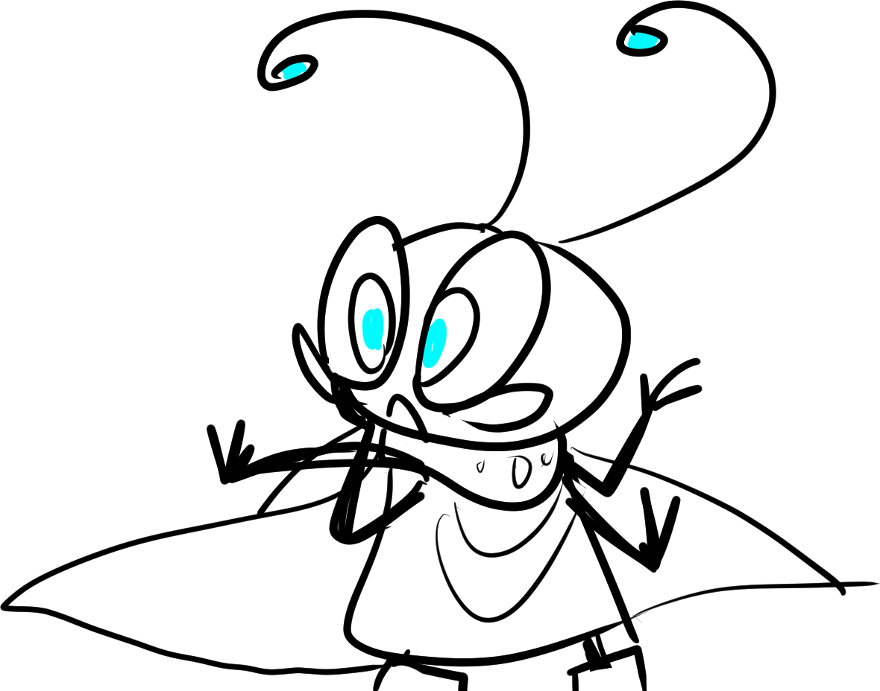
Right then! Deanna sensed magic!
Aesop is nearby! And there’s a whole lot of them!
Notes:
SHOW “bg stb2_page 9” with “stb2_page 9_deanna 1” at CENTER / ANIMATE between “stb2_page 9_aesop vfx 1” and “vfx 2” / FAST FADE TO “stb2_page 9_deanna 2” / FADE TO page 10.

Slide 11
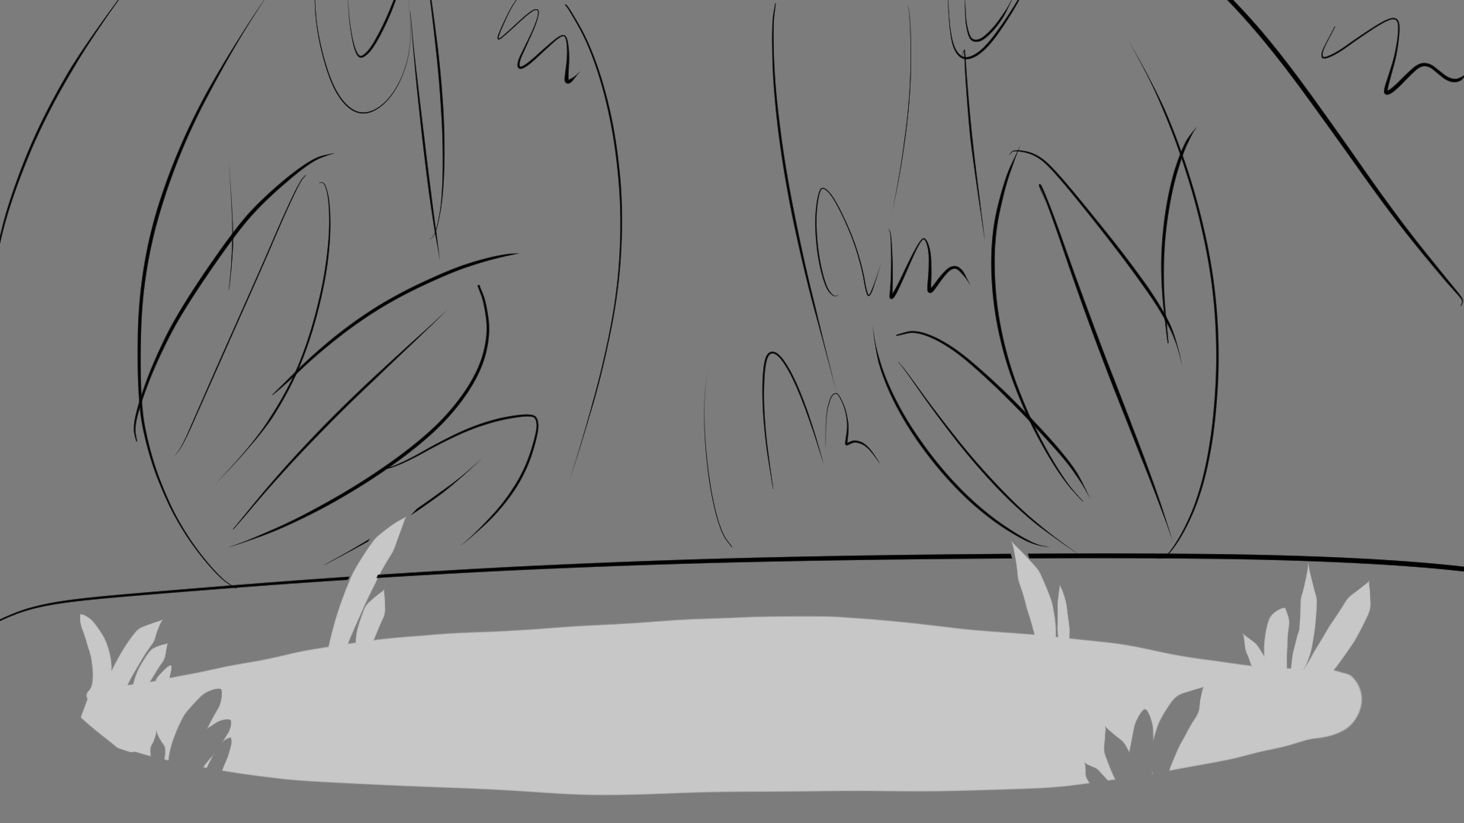
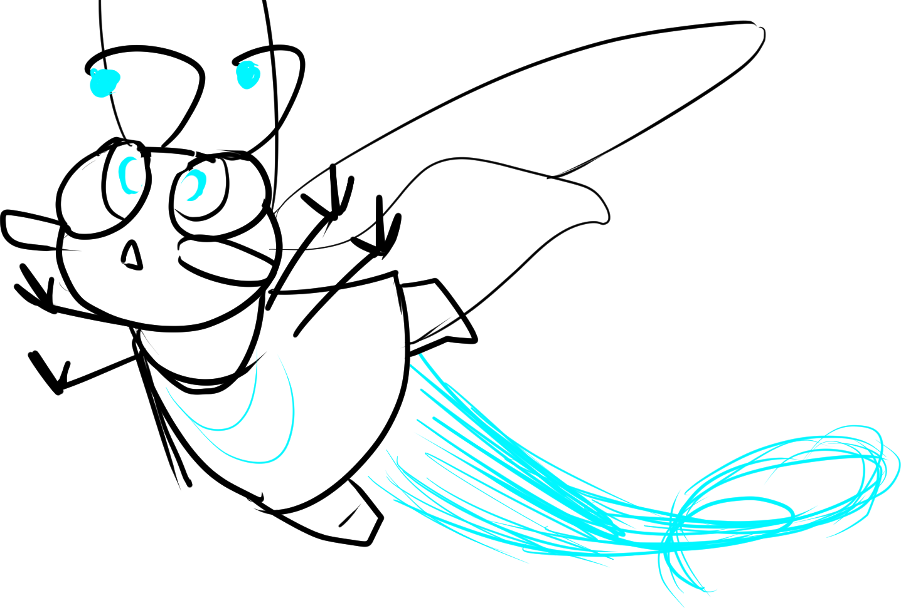
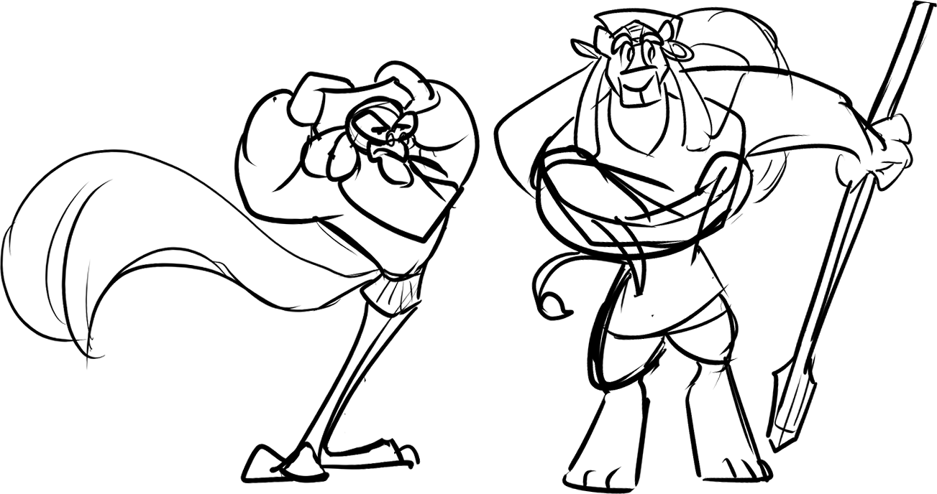
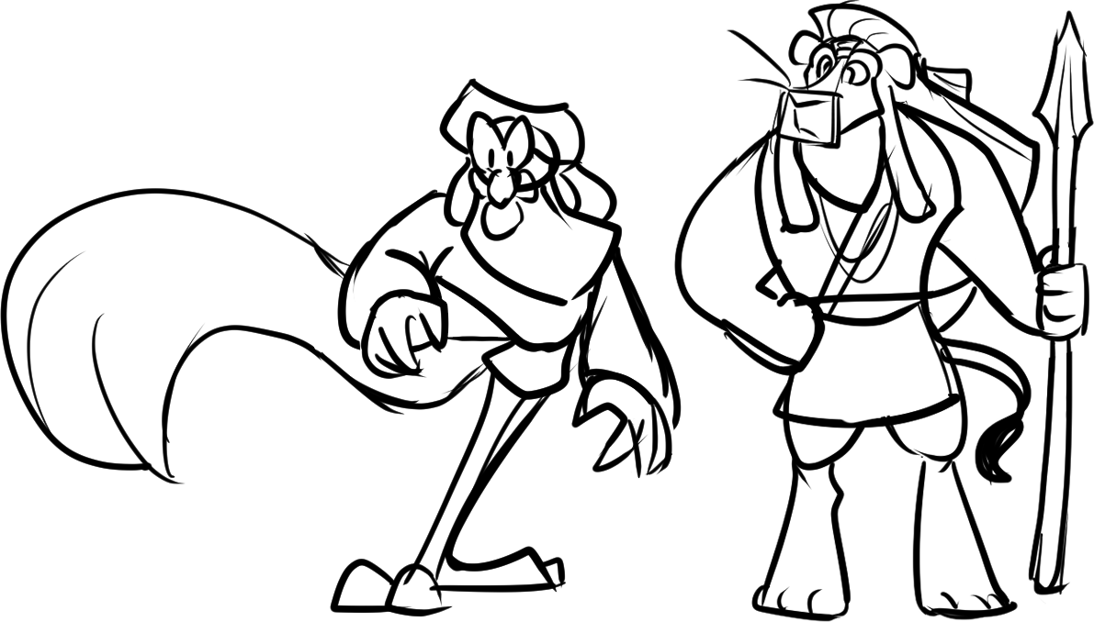

Deanna
“There’s wisps nearby!”
Off Deanna flew! She soared through the branches and vines, following the enchanted whispers without a second thought.
Notes:
SHOW “bg stb2_page 10” / SHOW “stb2_page 10_deanna 1” and “stb2_page 10_athos and lethabo 1” / ANIMATE TO “stb2_page 10_deanna 2” and “stb2_page 10_athos and lethabo 2” / FADE TO page 11.

Slide 12
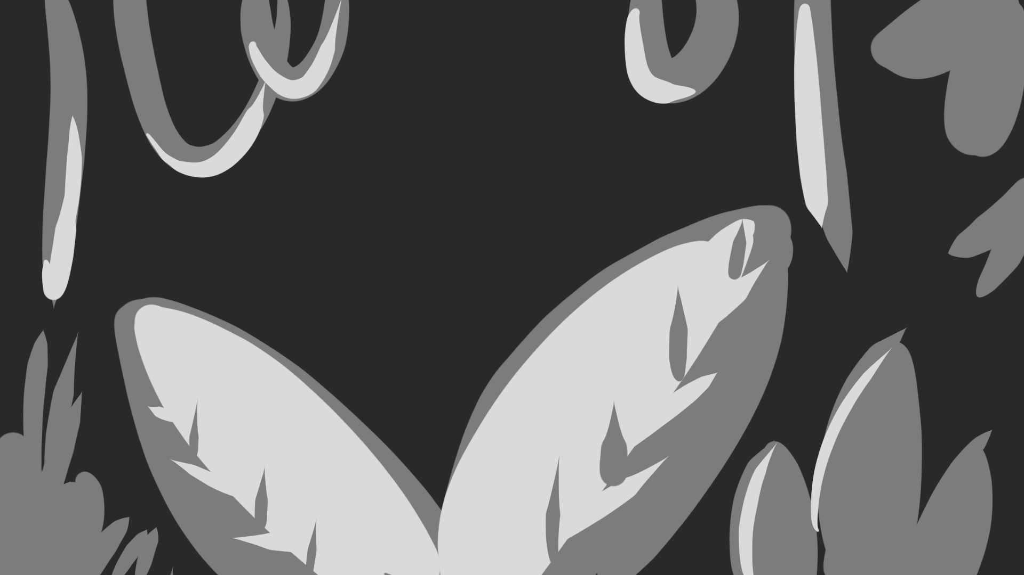
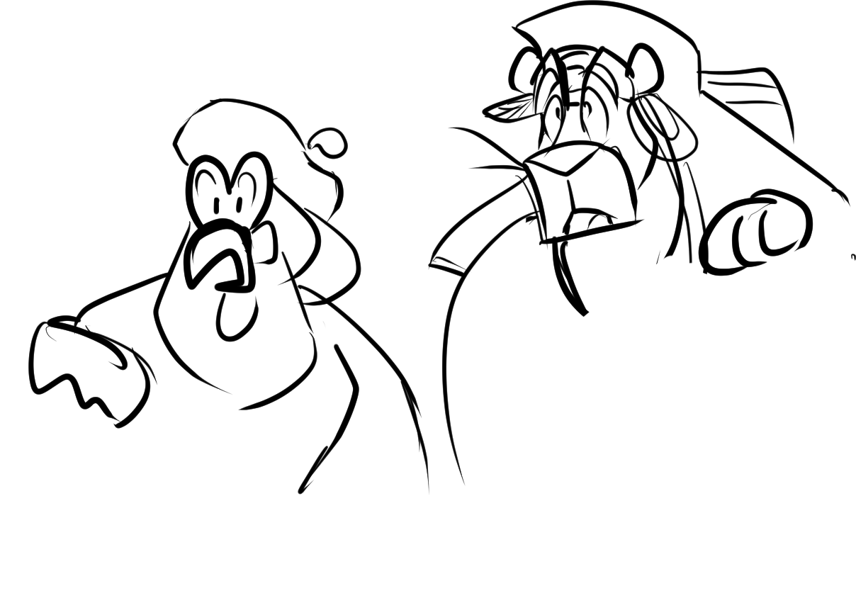

Deanna
Lethabo and Athos bumbled through the branches before they stopped in their tracks, their jaws dropping to the ground.
Deanna pushed herself through layers of foliage until, finally, she discovers an oh-so magical sight hat has her go starry-eyed.
“Ya-ho! Look at this, everyone!”
Notes:
SHOW “bg stb2_page 11” / FADE IN “stb2_page 11 / dialogue / FADE IN “stab2_page 11_athos and Lethabo” / dialogue / SLOW FADE TO page 12.

Slide 13
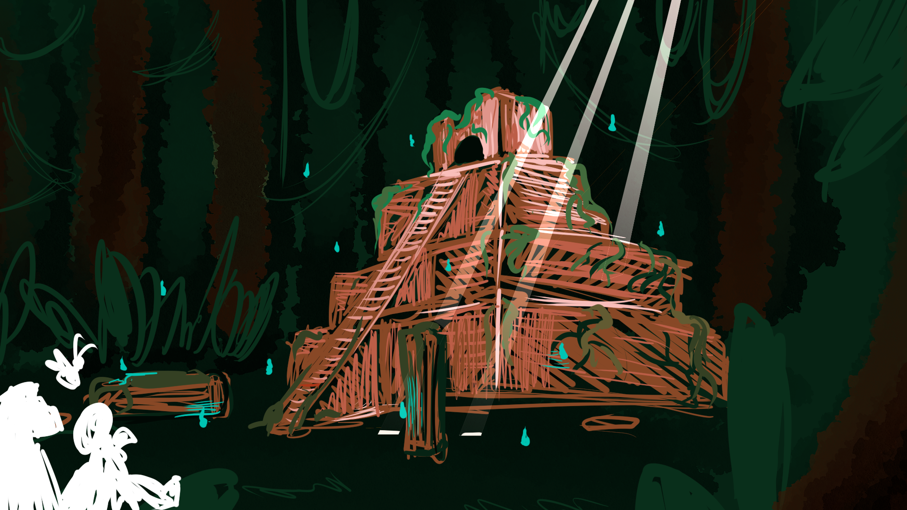
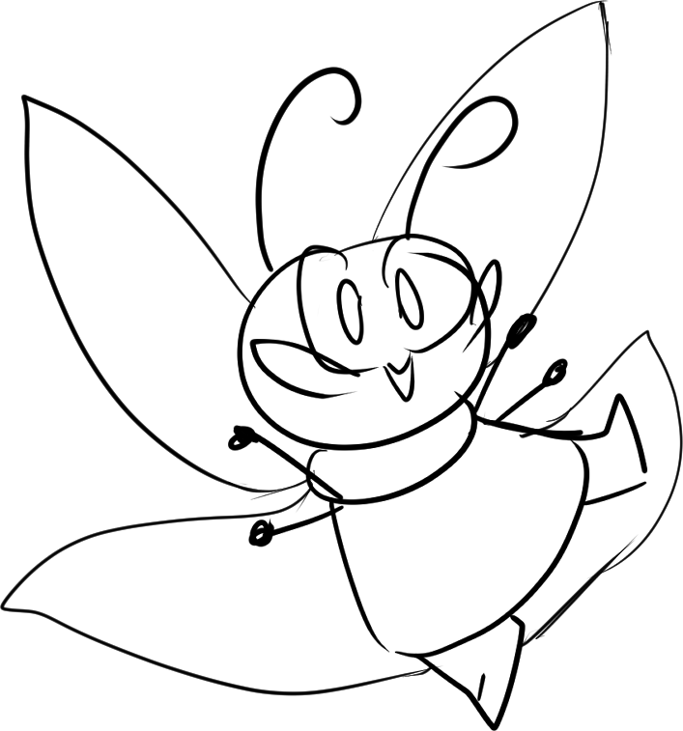
Deanna
What a sight! They found Aesop wisps all right, a whole flock of them surrounding some old, forgotten ruins on the forest floor!
“This is great! We’re sure to find a hero’s story here somewhere! Let’s go in!”
Notes:
SHOW ”bg stb2_page 12” / dialogue / TRANSITION TO Explore Mode 2.

Slide 14
END OF Storybook Mode 2
TRANSITION TO Explore Mode 2

